Slide 1

SUPERSTORE PERFORMANCE ANALYSIS
Team 27 Octave
Date: May 26, 2022

Slide 2
TEAM 27 MEMBERS
1. Paul Aderounmu
2. Kukoyi Zainab Oluwagbemisola
3. Kadiri Oluwafadejimi
3. Oyepeju Fawibe 4. Oyelakin Timothy Tomiwa 6. Gloria Ejikam
7. George Zachariah
8. Monsuru Shittu
9. Oladejo Toyyib Olalekan

Slide 3
TABLE OF CONTENT
1. Introduction
2. Background
3. Methodology
3. Analysis 4. Insights 6. Recommendation

Slide 4
INTRODUCTION
Superstore is a customer centric store located in the United State, operating in over 40 states across the country. The store has Three business categories which are: Furniture, Office Supply and Technology. The store has been in operation over the last 4 years.
The store is a proud supporter of US business and is committed to helping local enterprises, building relationships with leading suppliers, small businesses and securing a wide assortment of local brands.

Slide 5
BACKGROUND
With growing demands and cut-throat competition in the market, the store is seeking knowledge in understanding what works best for them.
They would like to understand which products, regions, categories, and customer segments they should target or avoid.
Building a Regression models/Times series to predict Sales or Profit.

Slide 6
METHODOLOGY
Approach and Timeline
May 17, 2022
May 18, 2022
May 19, 2022
May 25, 2022
1
2
3
4
Data and Requirement Gathering
-Data collection
- Understanding the business problem
Data Cleaning
-Exploratory data analysis
-Data quality issues
Data Analysis
Visualization
Time Series Analysis
- Data Model
Reports
Insights
Recommendation

Slide 7
ANALYSIS
Data Collection.
Octavia Data Team provided the data used for this analysis on the 17th May 2022.
Data Cleaning.
The following actions were performed in the process of cleaning the data:
The Row ID column was removed, as it was not necessary for the analysis.
The Order date and Ship date column was changed from text type to date type.
The Postal code column was changed from numeric type to text type.
Two extra columns was added to the data to create the XY and XSQ for the Regression model to predict Profit.
Visualization.
The clean data was imported to Microsoft Power BI, in order to build our visualization in arriving at the result or recommendation for the Superstore Giant, some measures were created using the quick measures to derive at the equation for the Regression Model.
The following insights were generated from our analysis:
The Profit by Discount.
The Sales and Profit by Category.
The Top 5 Sales by Cities.
The Bottom 5 Sales by Cities.
The Profit by Region.
The Sales by Month and Year.

Slide 8
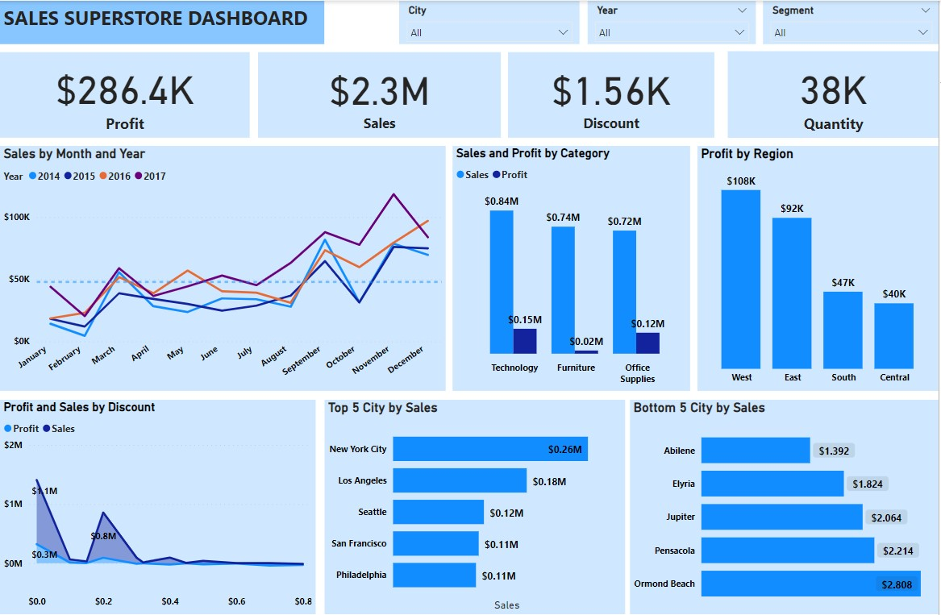
VISUALIZATION

Slide 9
ANALYSIS

Slide 10
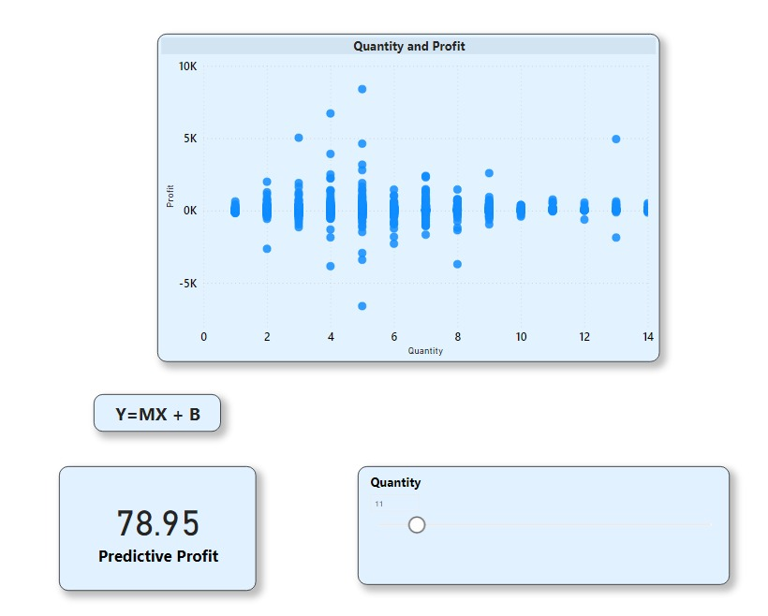
ANALYSIS
Regression Model

Slide 11
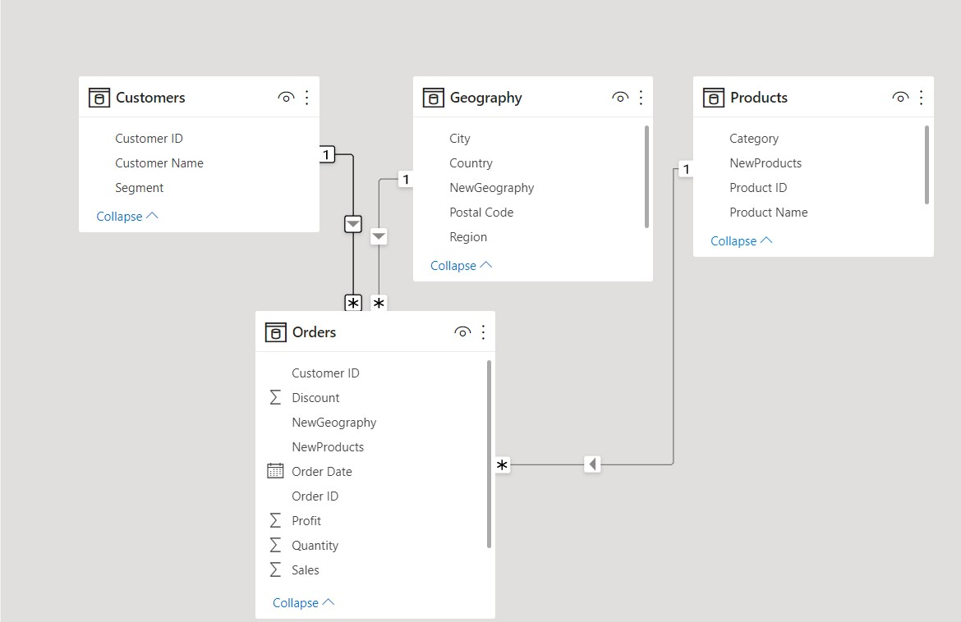
DATA MODELLING

Slide 12
INSIGHTS
The dataset used for this analysis contains 9,994 records and 21 variables.
SALES INSIGHT:
Superstore recorded a sales of 2.30M
Furniture products under category has 742K sales. Office supply has 719K sales, while Technology has 836K.
Technology has 6939 quantity and 244.40 discount. Office supply has 23K quantity and 947.80 discount. Furniture has 8028 quantity and 368.89 discount.
Top five cities by sales as shown on the clustered bar chart are New York, Los Angeles, San Francisco, Seattle, Philadelphia. while the bottom five are Orlando Beach, Pensacola, Jupiter, Elyria and Abilene.
The stacked area chart also shows that, the more the discount is increased, the more sales dropped (from 1.09M at 0.0 discount to 16K at 0.8 discount).

Slide 13
INSIGHTS
PROFIT INSIGHT:
The card on the dashboard shows a profit of 286.40K
Furniture category recorded 18.45K profit. Office supply recorded 122.49K profit, while Technology recorded 145k profit.
The same amount of discount and quantity applies to both profit and sales.
Top five cities by profit are within states like California, Washington, New York and Pennsylvania, while the bottom five cities by profit are within states like Ohio, Texas and Florida.
The stacked area chart shows a reduction in profit every time the discount increases. The profit goes from 320.987 at 0.0 discount to -30,539 at 0.80 discount.
The pie chart shows profit generated by region with west having the highest by 38%, followed by East with 32%, South with 16% and central by 14%

Slide 14
INSIGHTS
GENERAL INSIGHT:
Technology recorded the highest sales of 836K and profit of 145K, while Furniture has the second highest sales of 742K with the lowest profit of 18K.
Furniture category has the highest number of quantity (8028) and the second highest discount (368.89) and still recorded the lowest profit in the category. This shows that discount is not necessarily a determinant for profit growth.
The line chart shows an upward spike of above 50% of sales and profit during the last quarter of the year for the past 4years consecutively.
Furniture products has a 22% sales on the central region but no profit recorded which could be as a result of the losses incurred.

Slide 15
INSIGHTS
Times series insight:
We can see that there is a constant cycle/seasonality in each year, the 1st quarter records a low profit while the 4th records very high profit
We noticed an upward trend in profit with respect to time(year) i.e. as we move forward in time the higher the profit. Though slight variation.
We forecast an increase in profit, with a deep in 1st quarter and climax in 4th quarter.
Regression model:
We used quantity to predict profit
The model equation Is y(profit)=2.24+6.975x(quantity)
Adjusted R-squared: 0.00429 which means only 0.4% of profit was explained by quantity, we herby conclude that model is not fit for predicting.

Slide 16
RECOMMENDATION
RECOMMENDATIONS:
Since Furniture is having the second highest number of sales and the highest discount, but still records the lowest profit. I would recommend that the discount be removed and the products should return to its original price.
I would also recommend that products like tables, bookcases and supplies that recorded losses should be removed. Alternatively, the price should increase.
I also recommend that a marketing campaign should be done in cities/states that recorded low sales and profit.
Product awareness should also be done for product that recorded low sales/profit.
I would also recommend re-branding furniture products

Slide 17
THANK YOU!

